Slide 1

WELCOME

Slide 2
PRESENTATION ON WORKDAY BY M.VIJAY KUMAR 19121F0022

Slide 3
What is Workday ?
Workday is the cloud-based software package designed and developed to manage enterprise resource planning, human capital management, and financial management applications. Workday has multiple features used by every type of organization or small, medium, and large businesses. Human Capital Management refers to the functions included in Human Resources management like recruiting, developing, and optimizing human resources.

Slide 4
Features of workday
Workday is the software package that is developed with an intention to bring all the people to the center of the enterprise. Workday has come up with multiple features that have brought this tool with higher importance these days.
Let us have a quick review of the features of Workday.
FEATURES:
1.Human Resource Management
2.Talent management
3.Recruiting

Slide 5
1. Human Resource Management: Human Resource Management refers to the process of managing human resources for an organization. It usually includes hiring aspects that hold crucial importance. Human Resource Management helps in managing and organizing the workforce more effectively.
Features of Human resource management:
Absence management
Manager self-service
Employee self-service
2. Talent Management: Workday has come up with another feature called Talent management, a suite that includes multiple tools to enhance the management, development, and rewarding of employees. Talent management features consist of the functions that help in performance management, goal management, talent onboarding, career, developmental planning, succession planning .
Features:
Offers onboarding facilities
Goal management services
Performance-oriented managements
Succession planning methods

Slide 6
3. Recruiting: Recruitment refers to the process of identifying, recognizing the talents, and sharing their information, selecting the candidates for the positions available within the organization. Workday helps manage the recruitment processes, a tool that helps control the whole of the life cycle of the recruitment, enabling transparency and collaboration within the hiring team. Workday offers this feature providing the opportunity to analyze the open positions within the organization. It helps in creating and maintaining the recruitment strategies based on the real-time data available.
Features:
Provides headcount, pipeline, sourcing and screening analytics
Referral employee structure
Social media interactions
Selection process

Slide 7
Benefits of Workday
Benefits in Workday provide a solution for managing the organization's benefit plans to meet the unique needs
Let us have a quick review of the benefits of Workday.
Tracking of time: Workday provides the flexibility to the employees to track the time. Monitoring time is available on any device they log in like a tablet, desktop, mobile device, etc. Some of the organizations might require physical clocks. In such scenarios, Workday helps in integration with an Application programming interface, which is excellent to track the time as and when needed
Features of time tracking:
Enables user to enter global time.
Mobile device and web time clocks
2. Payroll: Payroll processing in an organization is an essential task that allows the users to perform the payroll calculations as and when required. It helps in performing audit analysis and reports. Workday cloud connect for third party payroll also made it simple for the payroll teams to integrate with third-party providers. Workday allows the users to access the payroll data irrespective of the time frames.

Slide 8
Features:
Offers self-service methods
Automatic tax updates
Auditing and reporting
Third-party cloud-connect payroll.
3. Big Data Analytics: Workday Big Data Analytics helps in collaborating the non-workday data sources with Workday.
Features of Big data Analytics:
Workday and non-workday data sources combined may be unstructured data and large voluminous data.
Offers single-platform security and user-experience applications.

Slide 9
Disadvantages
Many screens in Workday have several scroll bars that can make navigating Workday difficult.
Creating and merging custom security groups is not an easy task from the client side of Workday.

Slide 10
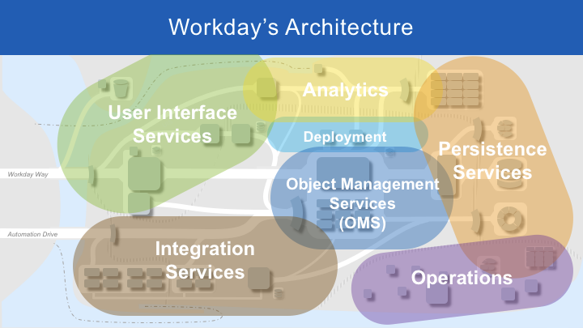

Slide 11
Workday Architecture :
Workday applications are designed and developed with an architecture that follows a highly object-oriented structure. The flexible architecture of Workday facilitates the continuous and non-disruptive evolution of technology.
Let us have a quick review of the architecture of Workday.
The architecture of workday includes the following main components.
1.UI server 2.Object Management Server 3.Integration Server 4.Persistent store
Let us gain some understanding of each component.

Slide 12
UI Server: The UI server is a process that provides communication services between event consoles and the event server, and between event consoles and the event database. It communicates with the dispatch engine when it needs contact with the event server.
The UI Server is flexible in providing the following aspects.
Flash/flex based
Wide browser support
Mobile HTML
The entry point for end-users
PDF export
Excel export
2. Object Management Server: The Object Management server is the central processing engine in workday architecture. The object management server is responsible for handling the services UI, and data requests usually come from UI server and integration servers.
3. Integration server: Workday is designed as a web service platform that is heavily into SOAP (Simple Object Access Protocol).
4. Persistent store: All the available data or changes and modifications will be captured in the database. The persistent store is responsible for data backups and data replications.

Slide 13
What is the log book ?
A log book is a book in which someone records details and events relating to something .
What is server ?
.
A server is a computer program or device that provides a service to another computer program and its user, also known as the client.
What is Database ?
A database is an organized collection of data , so that it can be easily accessed and managed

Slide 14
THANK YOU

